Slide 1





SB X MOTUS X SU
PATCH PERFeCT – USING AI TO FIX ROADS
2024
1

Slide 2
LAUNCH AGENDA (VIRTUAL)
TIME | Duration | AGENDA ITEM | PRESENTER
17:30 | 10 minutes | Greetings and introduction (SU) | Sunday and Prof K.
 | 5 minutes | Welcome (SB) | Andy H. and John M.
 | 5 minutes | What the SB CIB team is about | Stephanie
 | 5 minutes | Welcome (Motus) and importance of topic | Gary Scott – Chief Digital Officer
 | 10 minutes | Brief – challenge statement and description and mentoring and judges and pics | Miren, Murali
 | 5 minutes | Rules of engagement and registration details | Stephanie
 | 5 minutes | Open to questions from floor / students | Prof K. / Sunday
18:15 | 2 minutes | Closing , acknowledgements | John M and Prof K.

Slide 3
FINALS AGENDA (In-Person)
**dial in link will be available for guests
EVENT | TIME | AGENDA ITEM | PRESENTER
 | 17:30 | Arrival (drinks and snacks) | All
 | 18:00 | Welcome (MC) | TBC
 | 18h15 | Welcome – SU, SB, Motus | TBC
 | 18h30 | Team 1 – Team 5 presentations, including judges feedback, Q+A and comments | Teams
 | 19h45 | Judges deliberation and voting count | Sunday / Prof K.
 | 20h00 | Winners announced | Prof K. / Dr Sunday
 | 20h15 | Closing, acknowledgments | Prok K /Dr Sunday

Slide 4
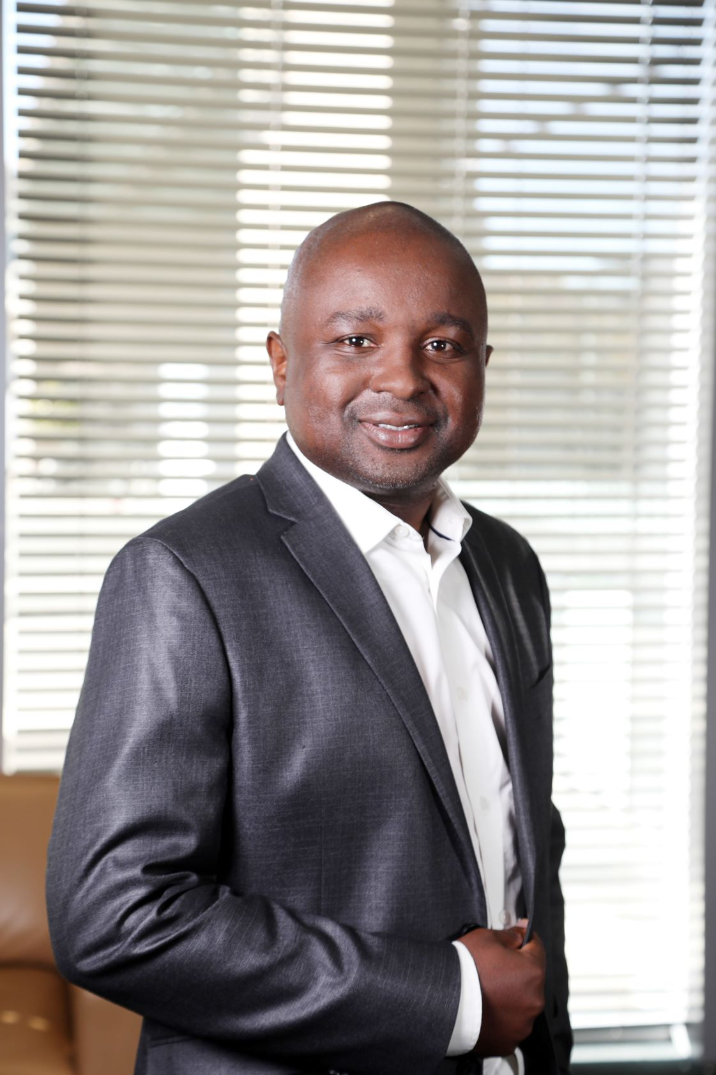
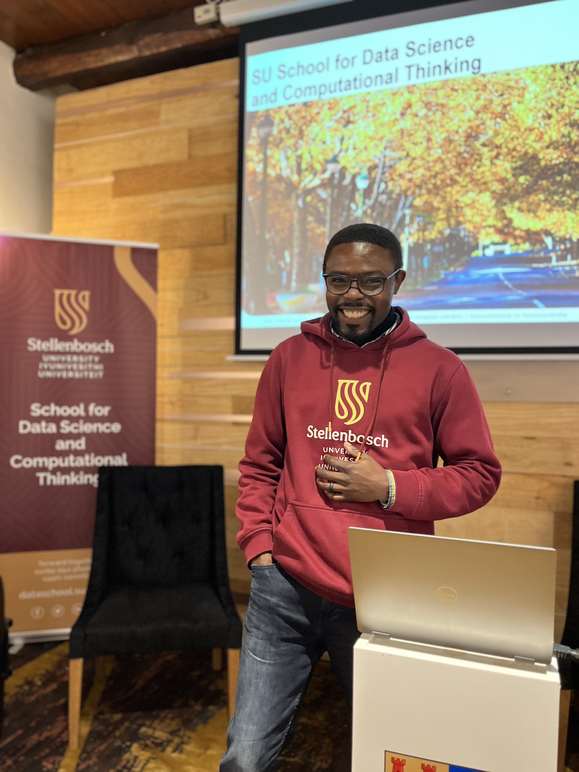
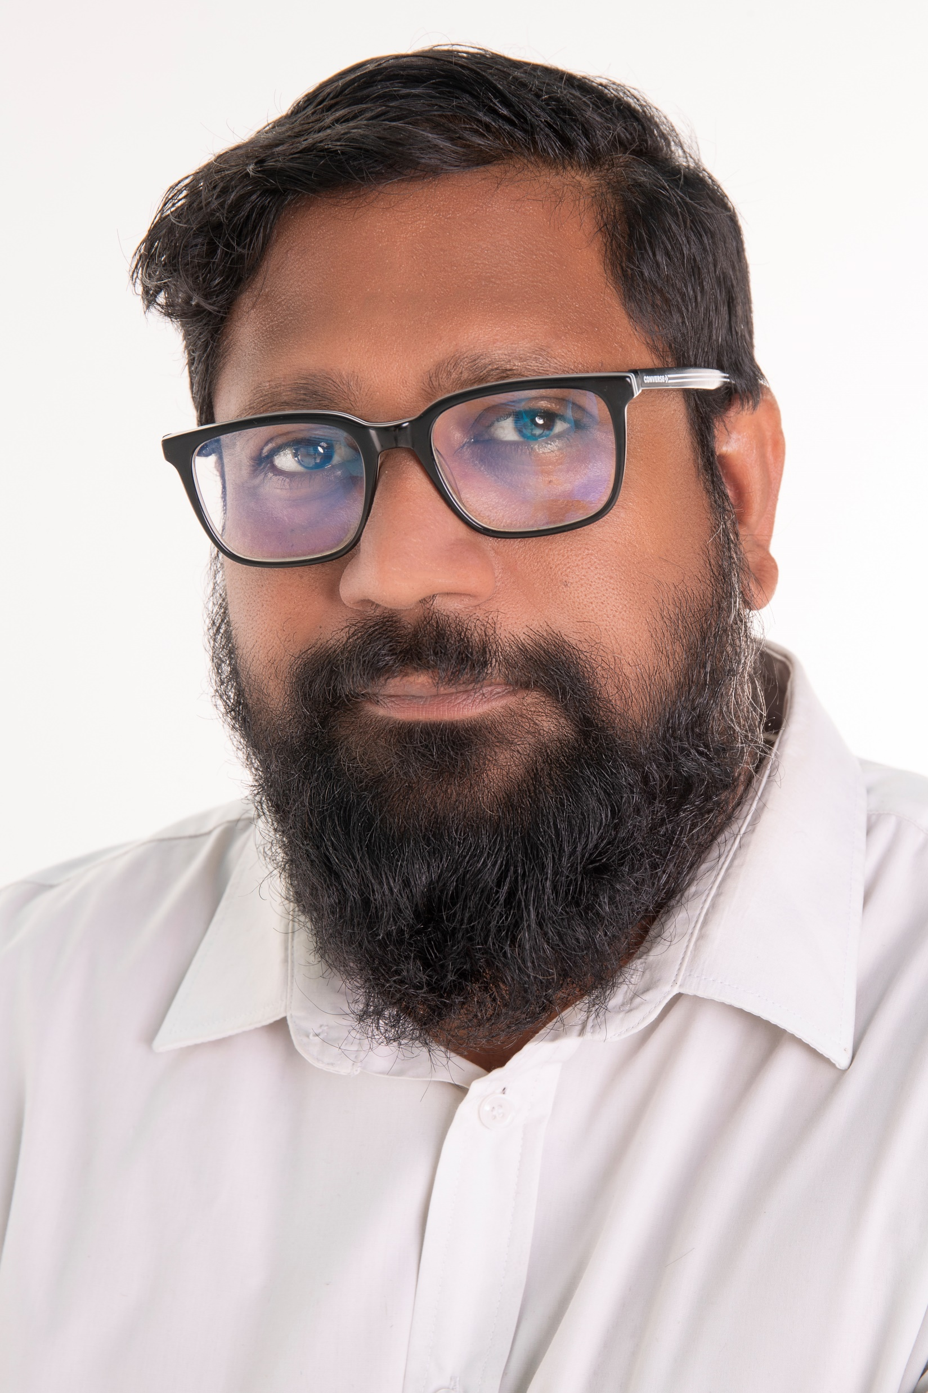
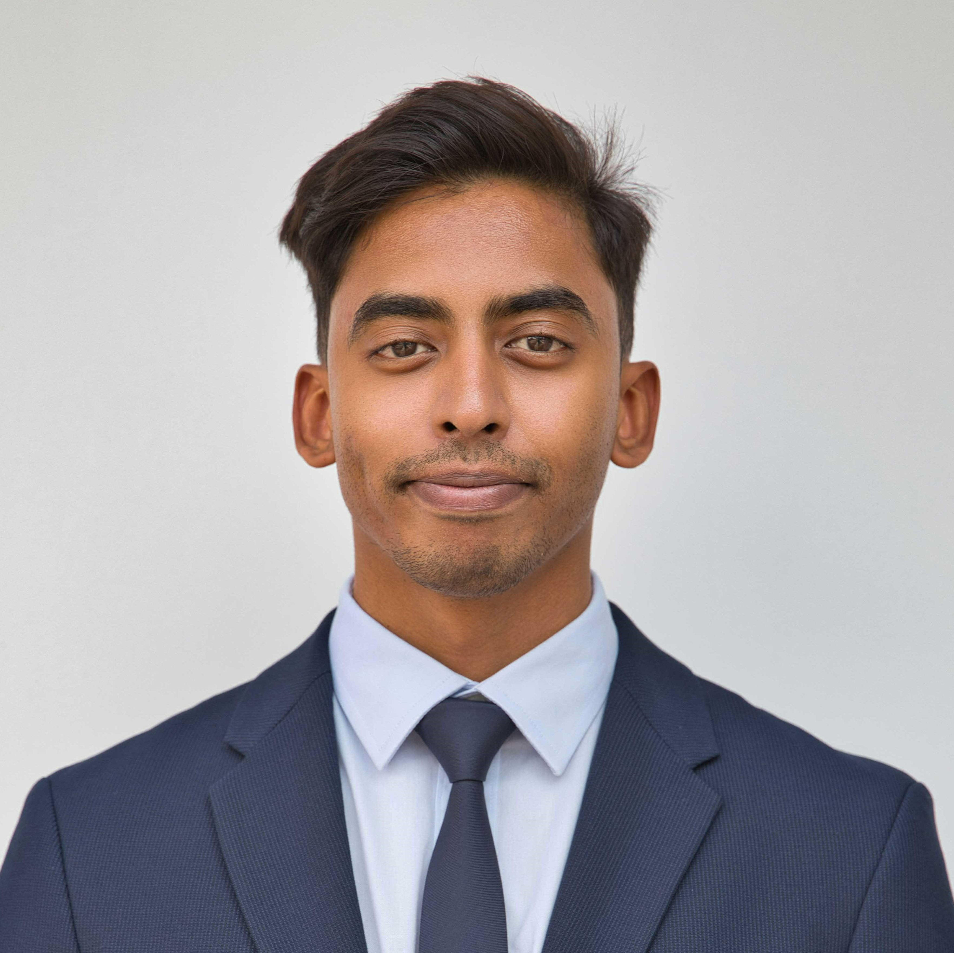
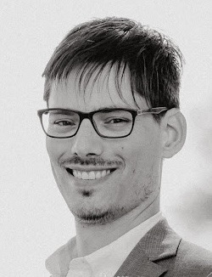
Meet the Judges – Round 1
John Mukomberanwa
Head of Data and Insights
CIB Digital
Dr Sunday Oladejo
School of Data Science and Computational Thinking
Stellenbosch University
Murali Veeraragoo
Computer Vision Specialist
CIB Digital
Miren Bitcham
Data Scientist
CIB Digital
Dr Gray Manicom
Postdoctoral Researcher
Stellenbosch University

Slide 5
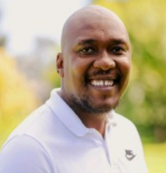
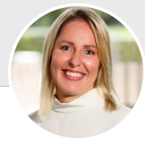
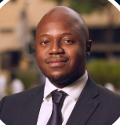
Meet the Judges – Finals
John Mukomberanwa
Head of Data and Insights
CIB Digital
Dr Sunday Oladejo
School of Data Science and Computational Thinking
Stellenbosch University
Ofentse Motaung
M-X Innovation
Motus
Heidi Taylor
Legal Specialist, Digital Technology
CIB Digital
Musa Malwandla
Co-Chief Investment Office: Artificial Intelligence
Differential Capital

